Slide 1



Slide 2
Members of the Project
Sai siddardha Chebrolu
Sandesh Reddy Tummala
Vijay Rama Rao Pothuganti
Sai Kumar Reddy Vakiti

Slide 3
API’s Implemented
Mongoose and Mongo data base.
Upload doctor profile picture in Cloudinary.
React Leaf-let.

Slide 4
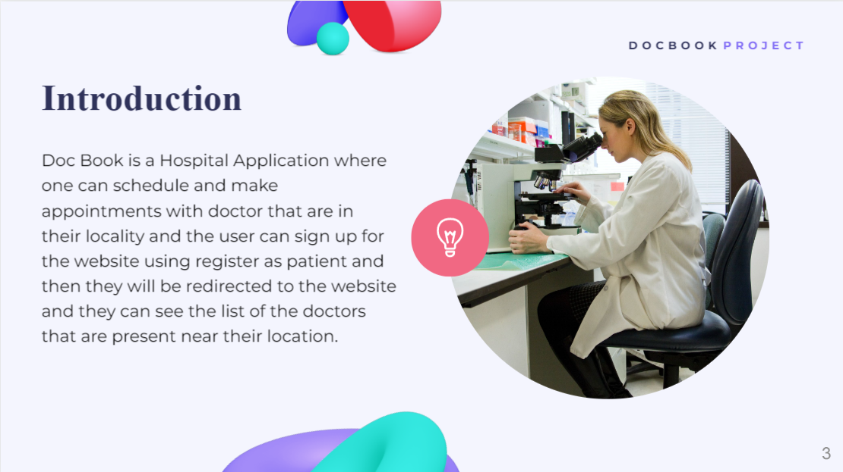
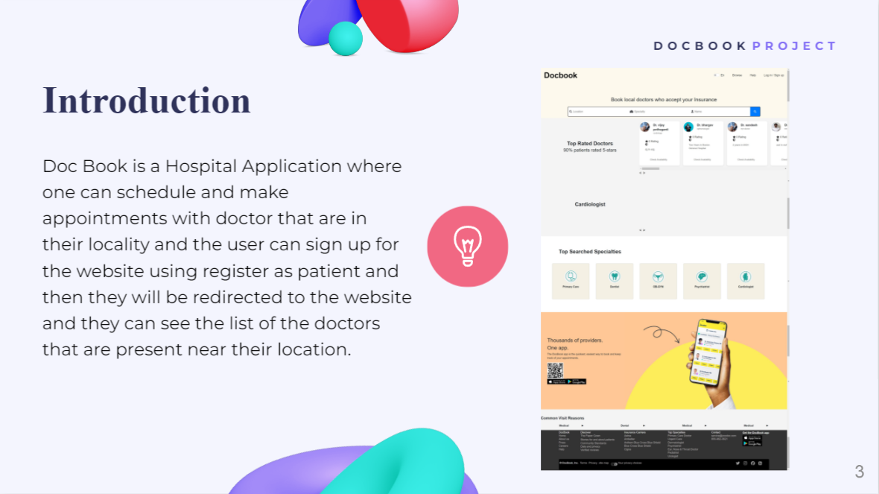
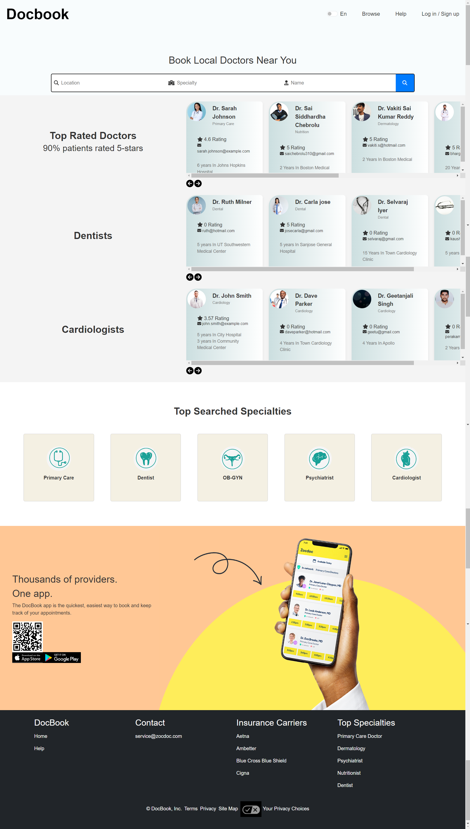
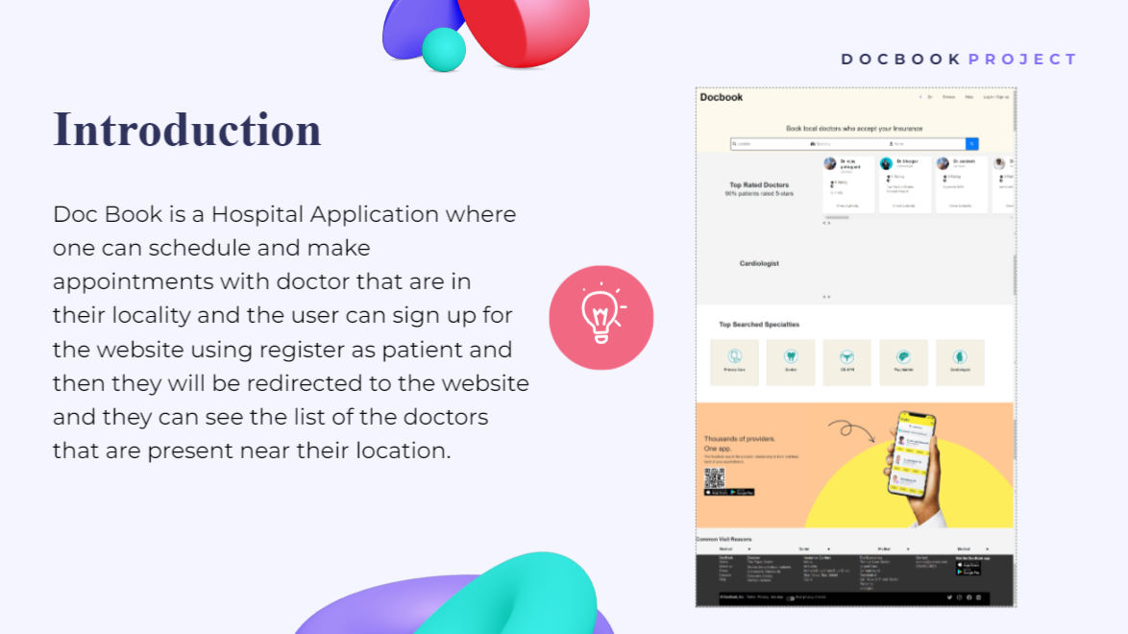
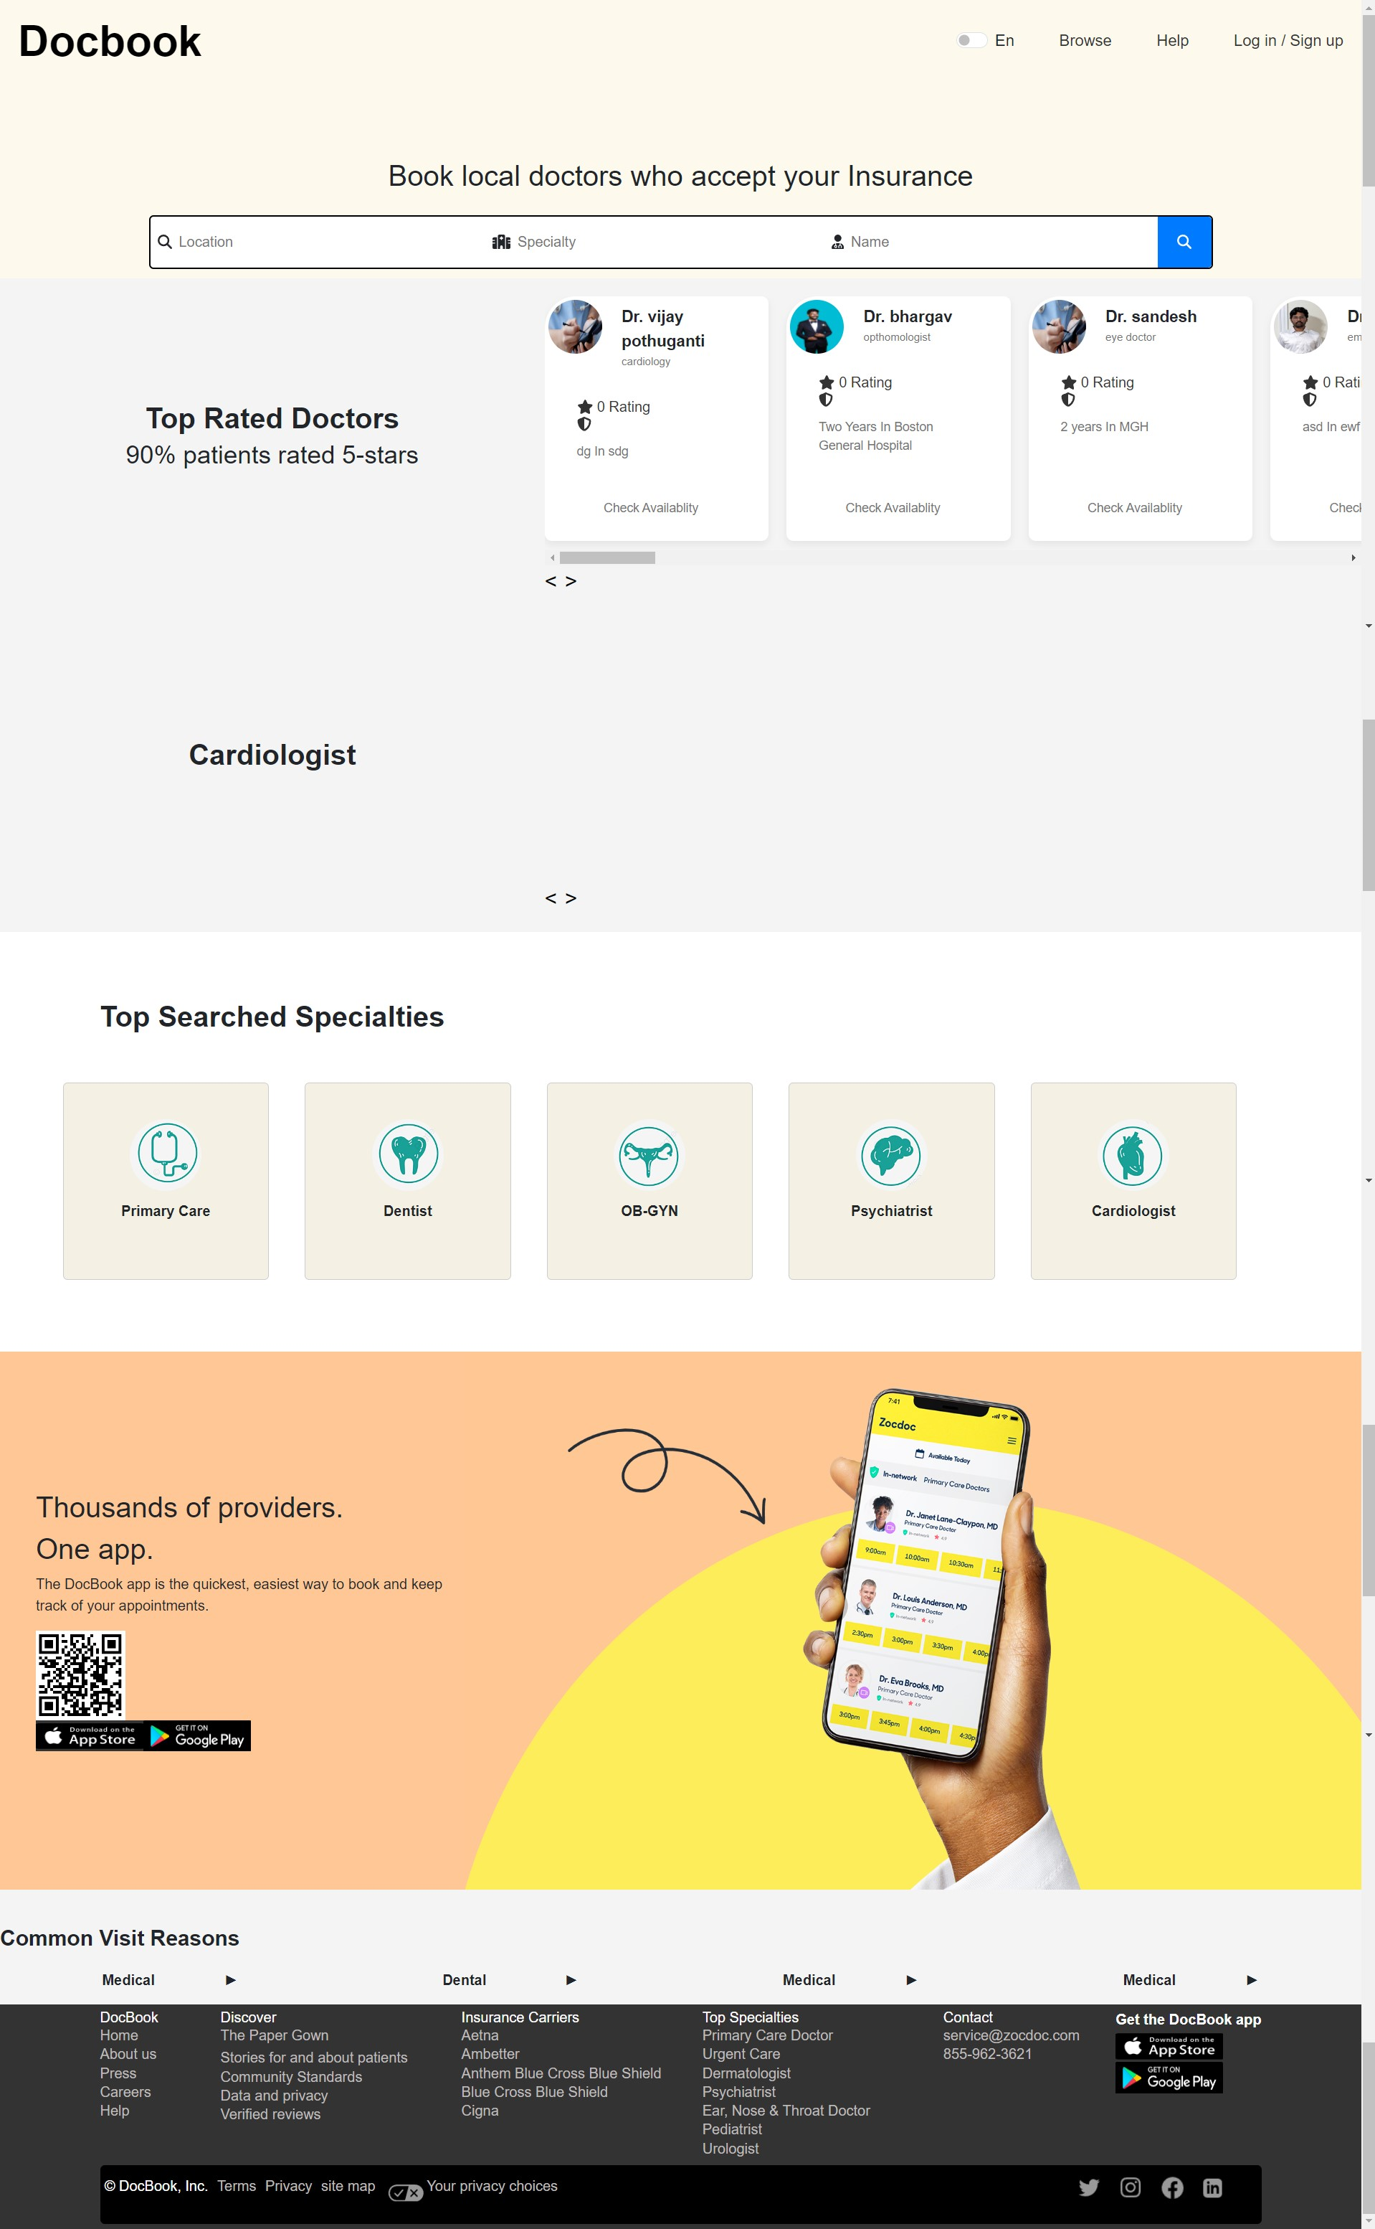

Slide 5
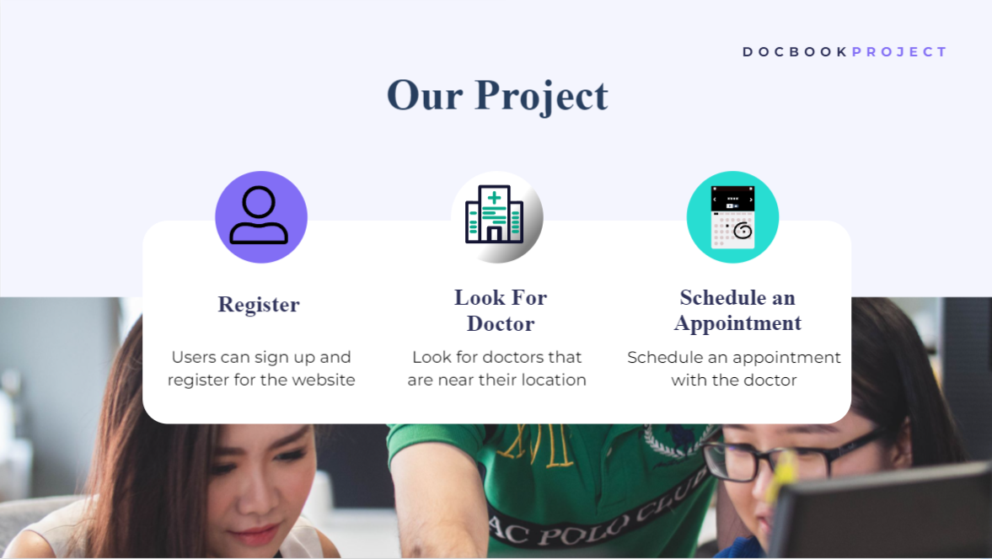
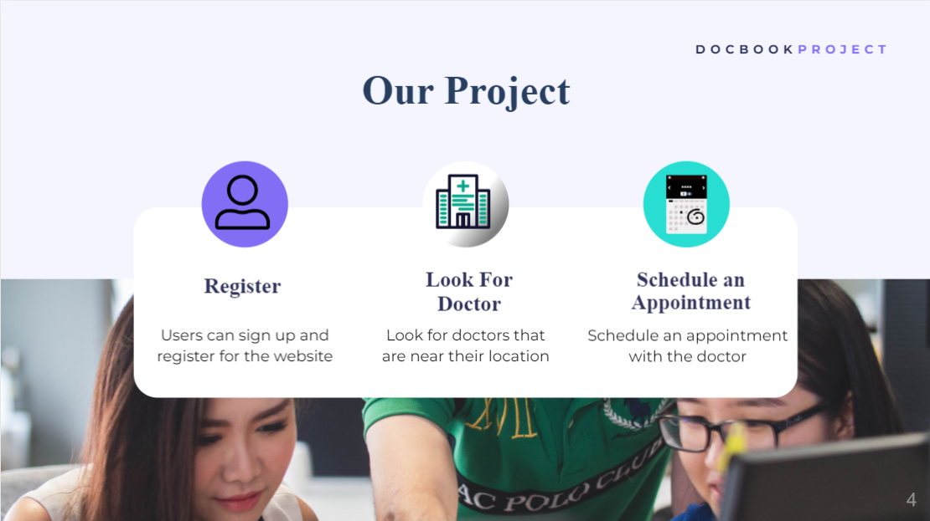

Slide 6
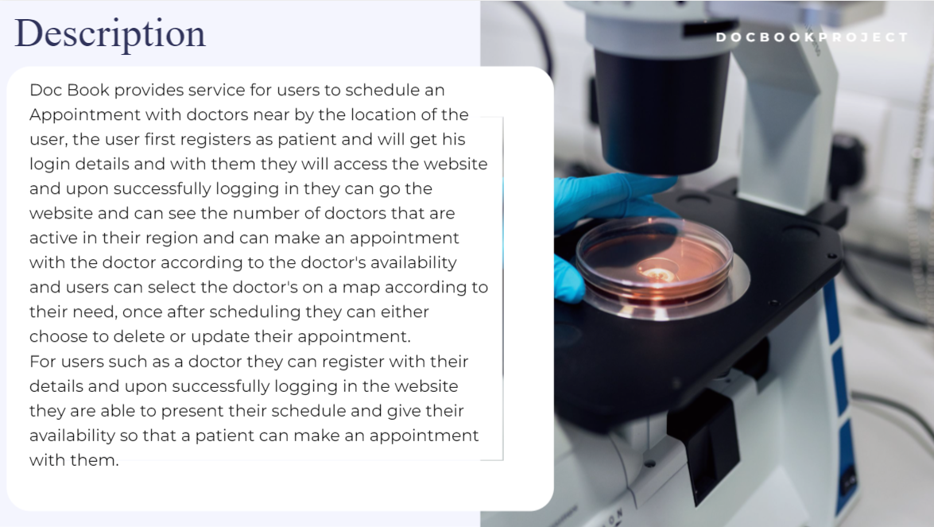
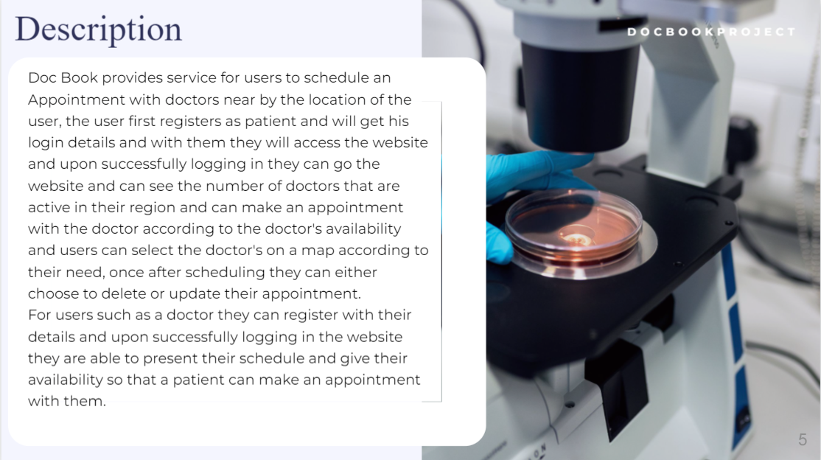

Slide 7
Tech Stack used
React
Node
Mongoose
Redux
Type Script
Boot Strap
Express

Slide 8
Home Page

Slide 9
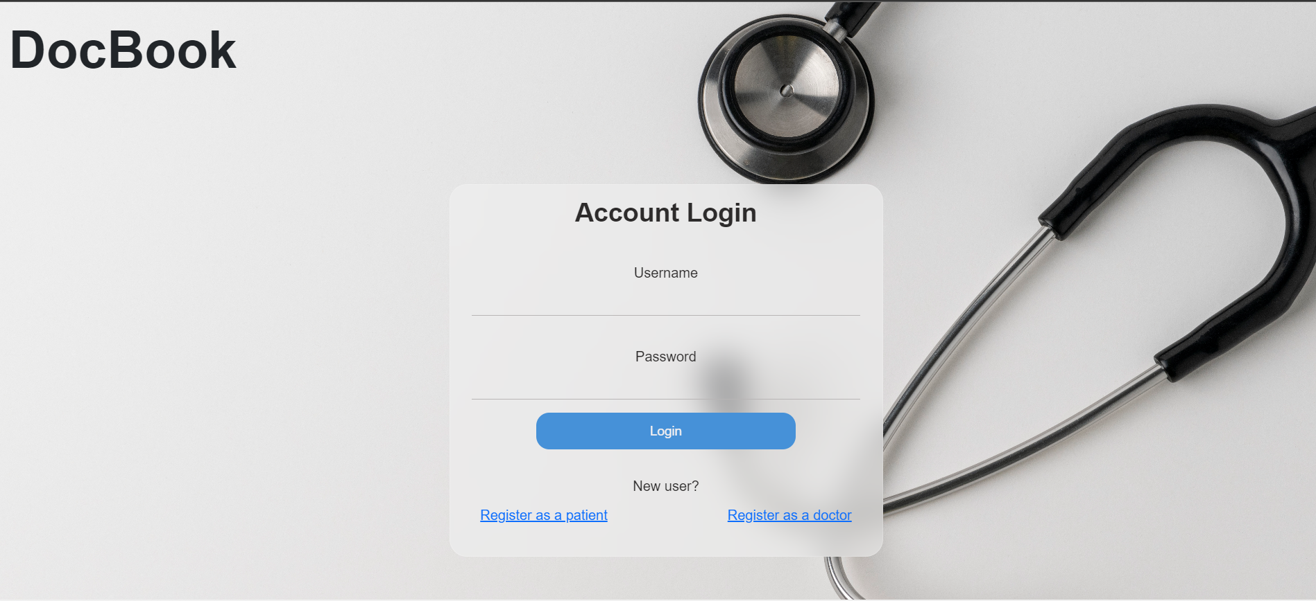
Login Page to the website

Slide 10
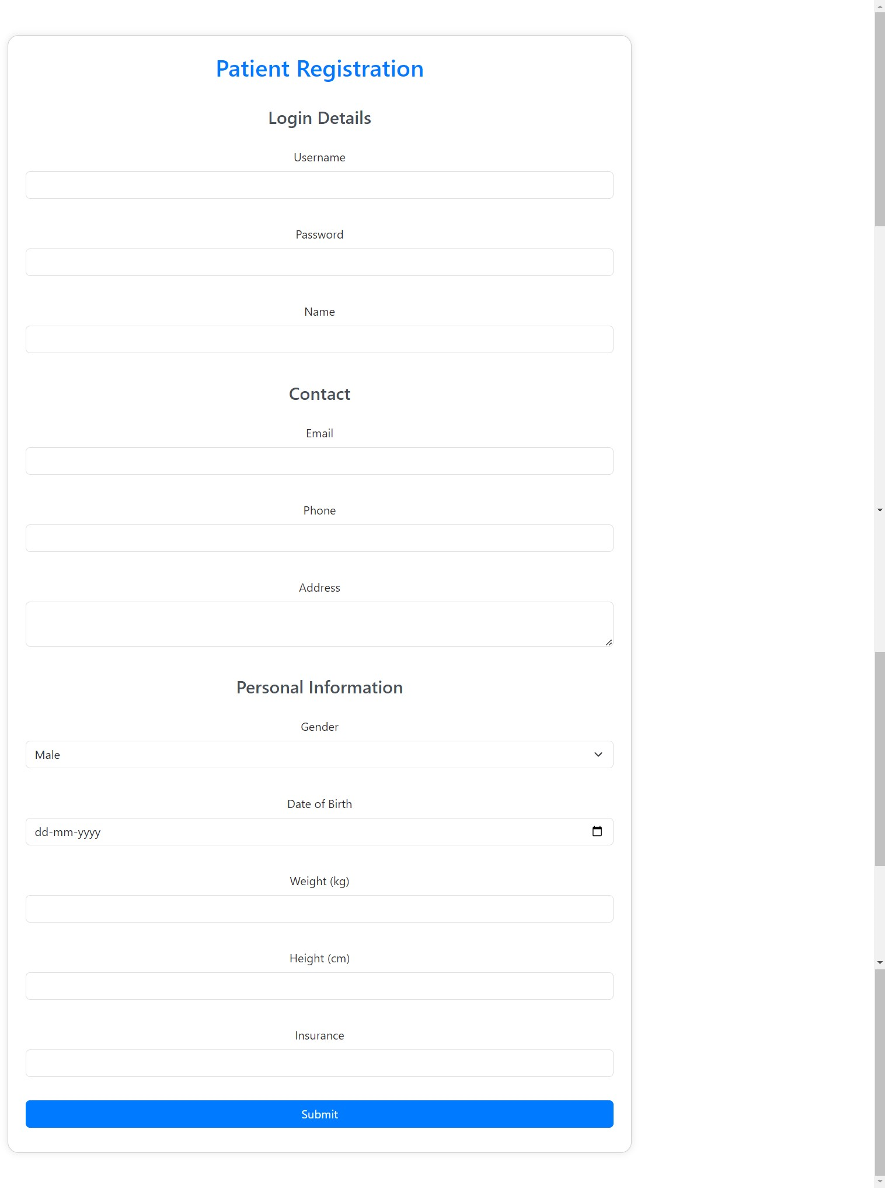
Patient Registration Form

Slide 11
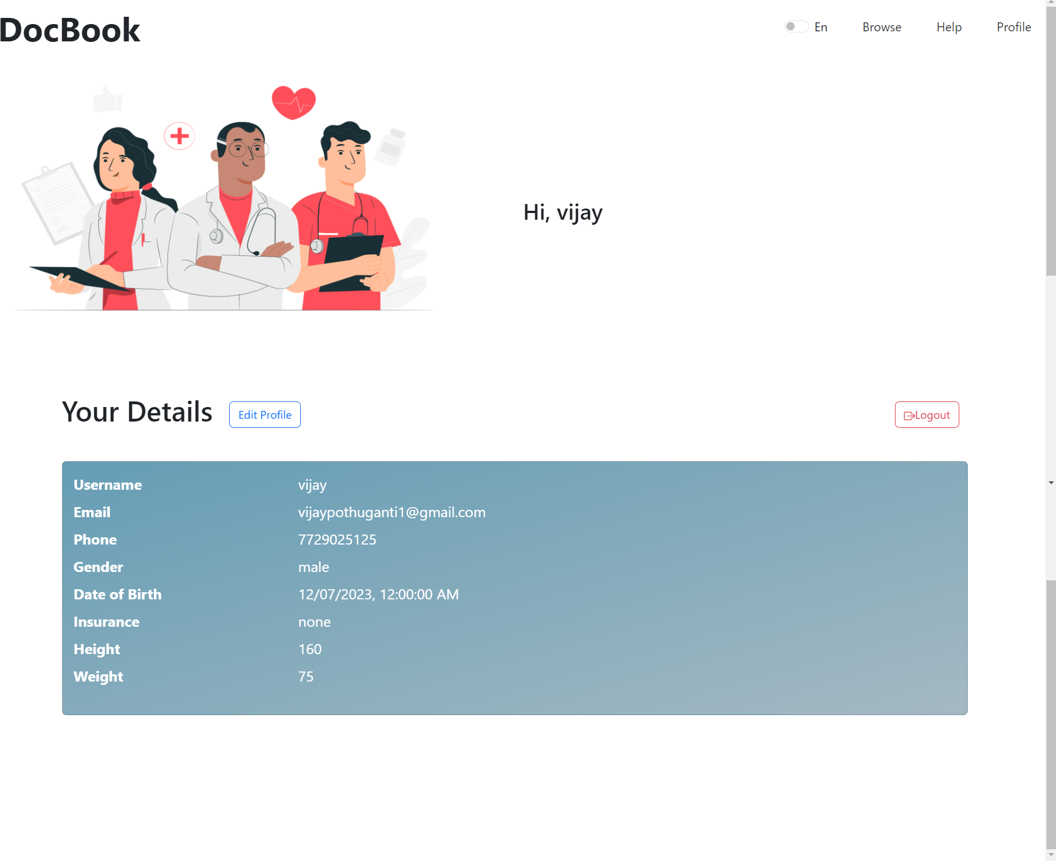
Patient Profile Page

Slide 12
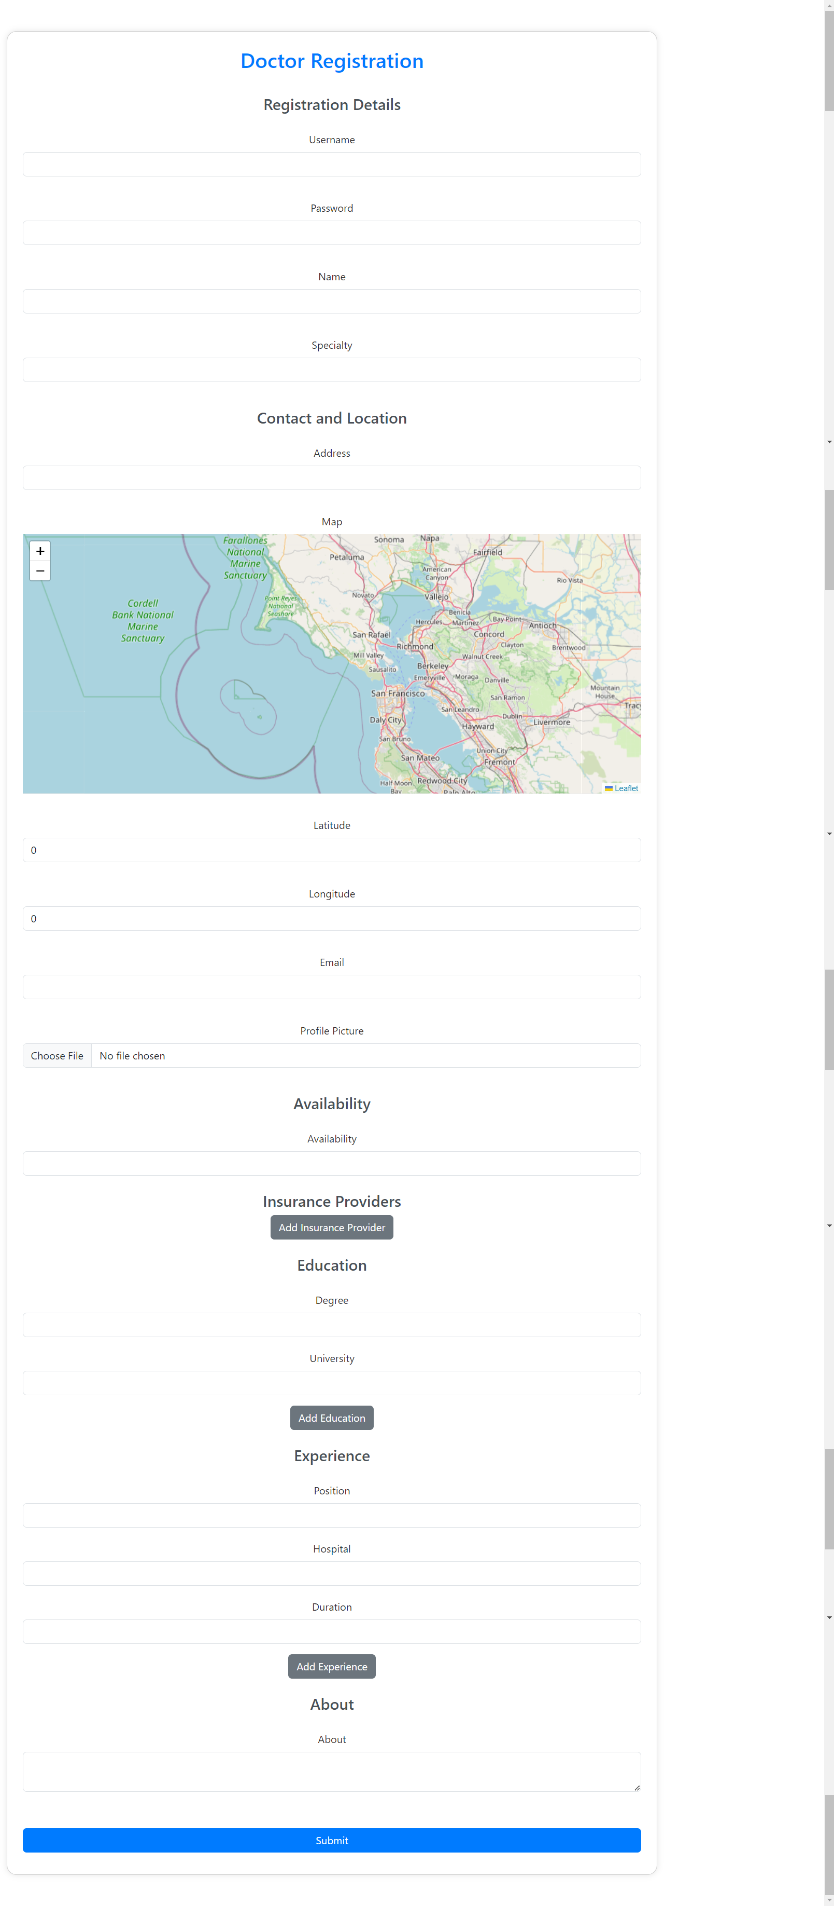
Doctor Registration Form

Slide 13
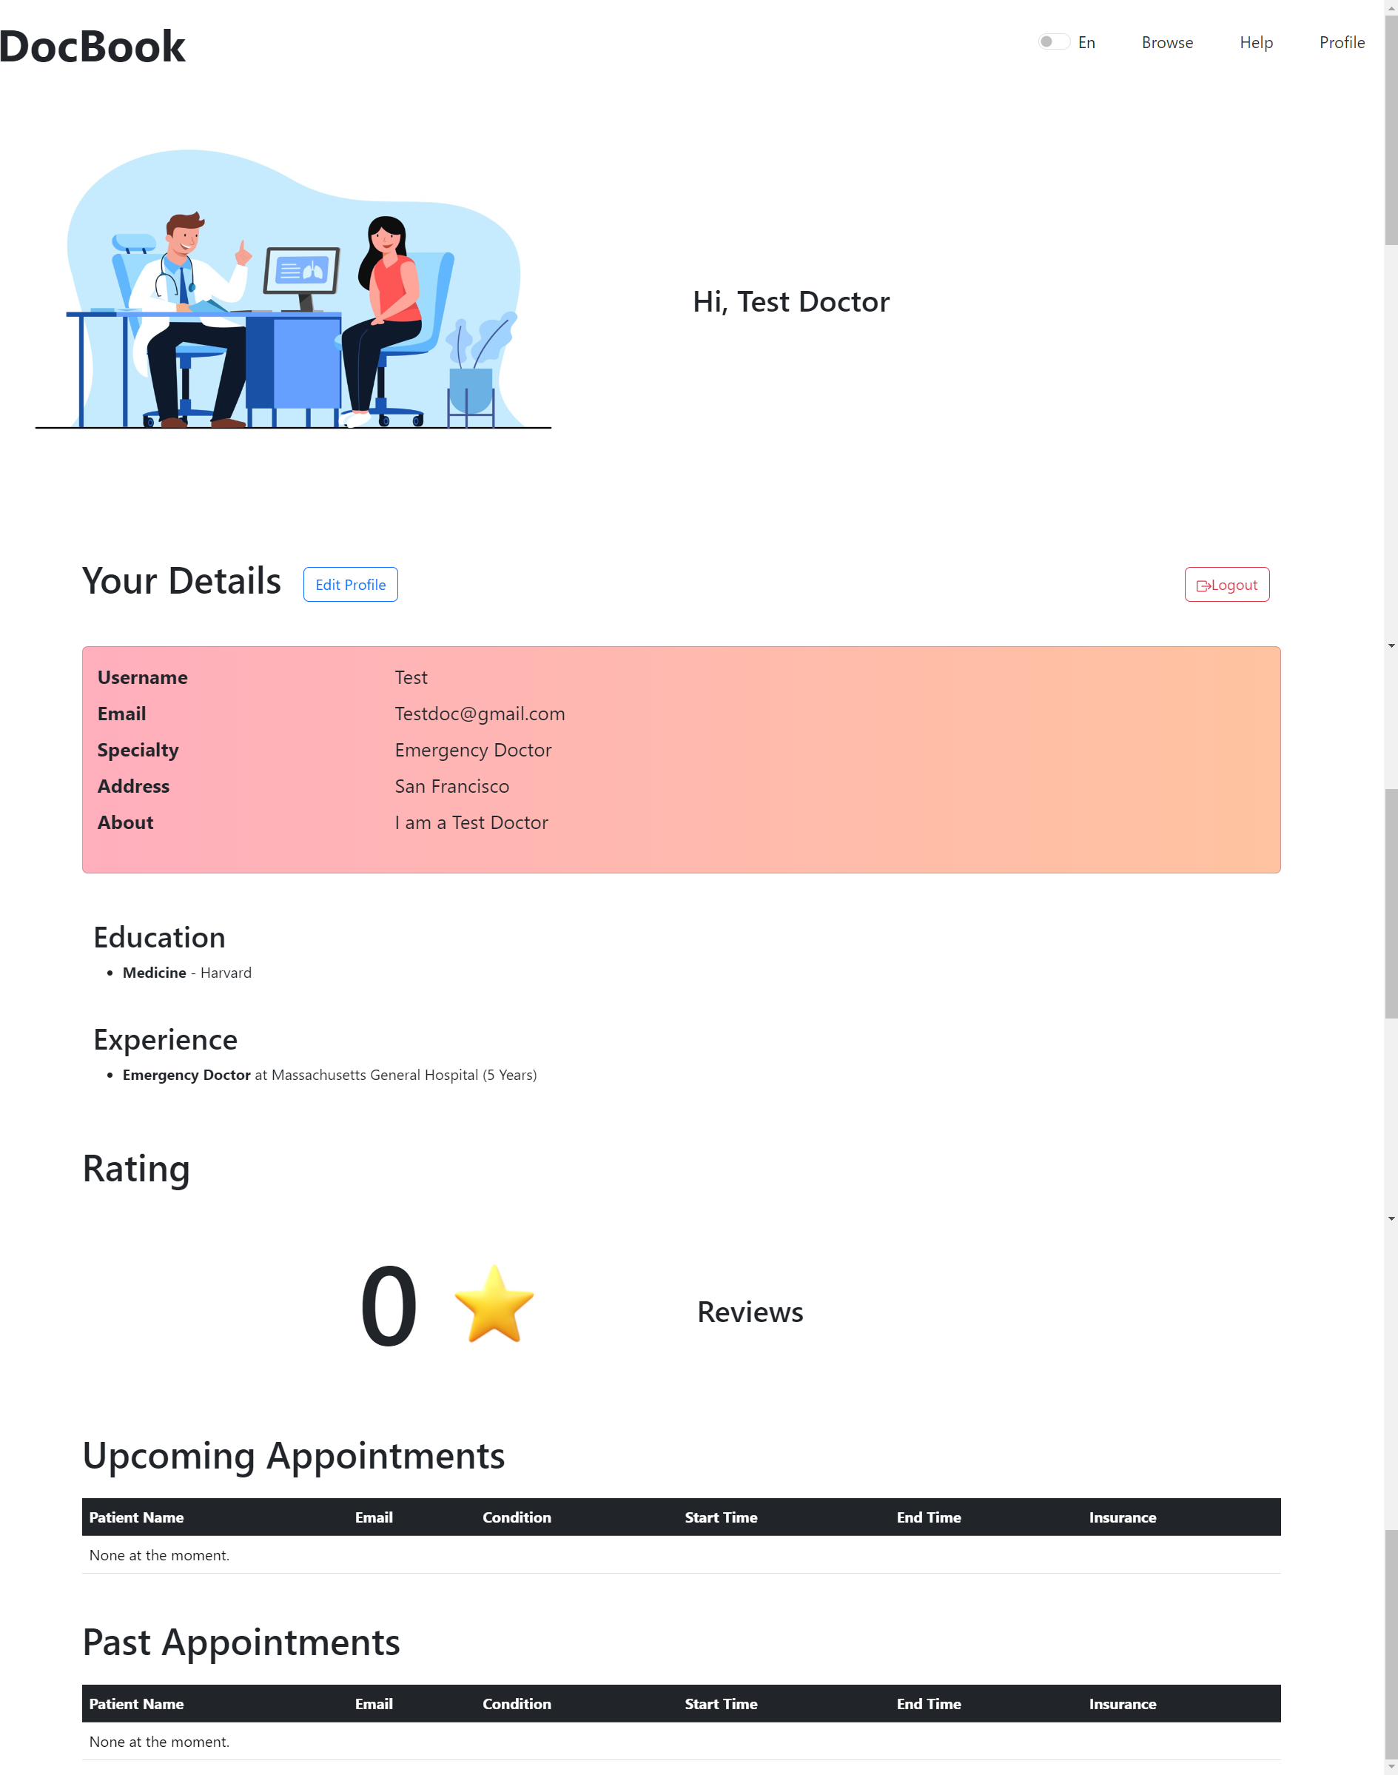
Doctor Profile Page

Slide 14
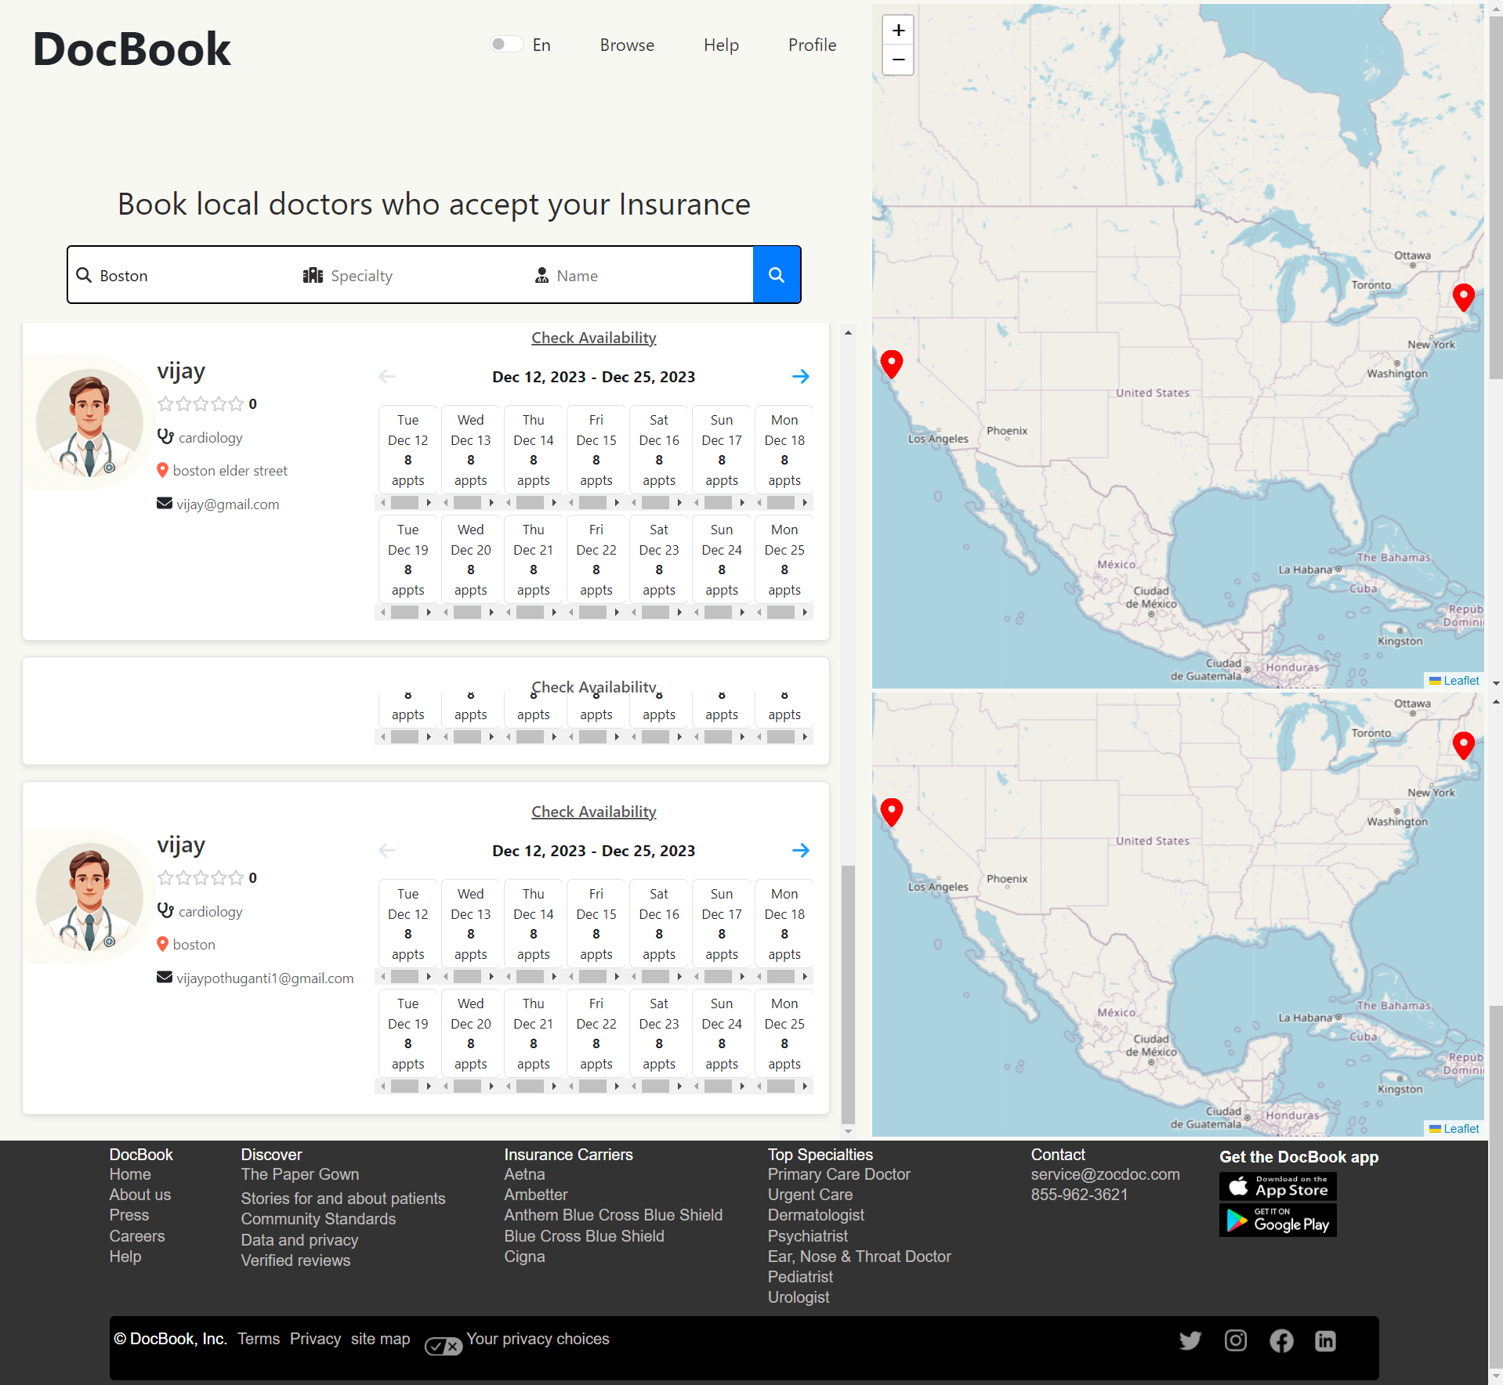
Browse Page in doctors

Slide 15
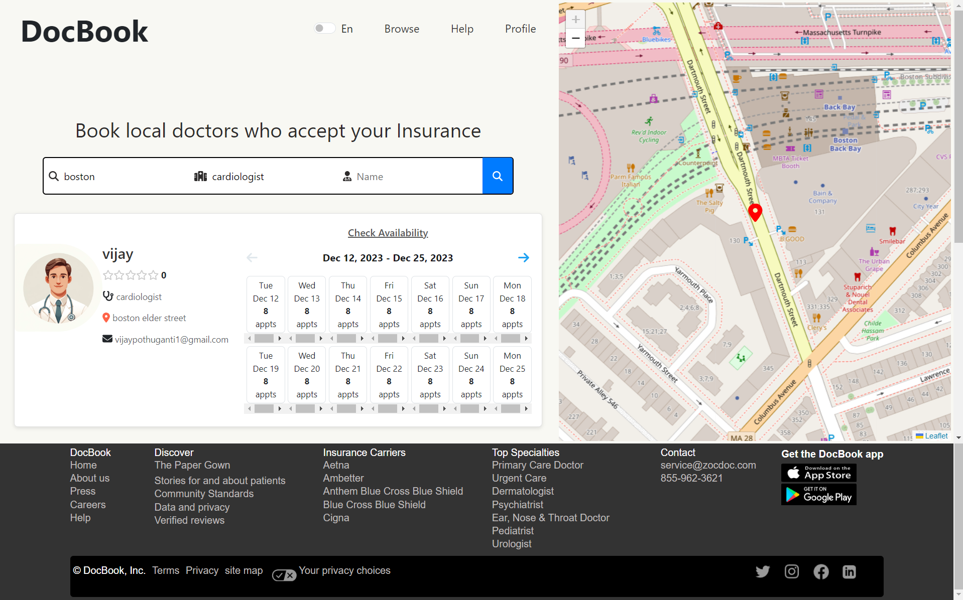
Browsing Page continued

Slide 16
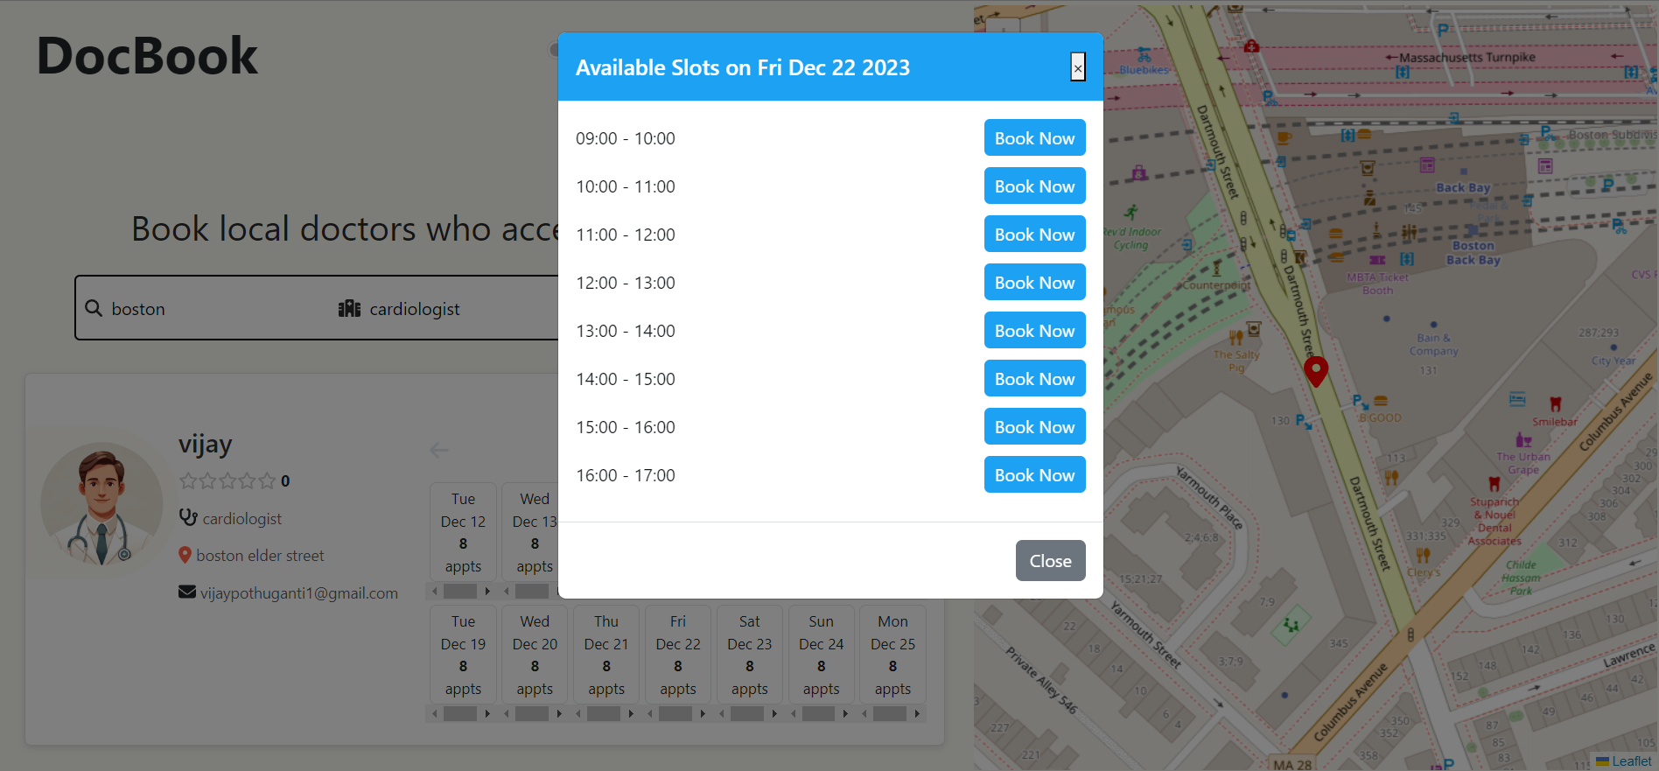
When Clicked on the Available calendar it shows the number of slots available, and the user can select a slot which he wants.

Slide 17
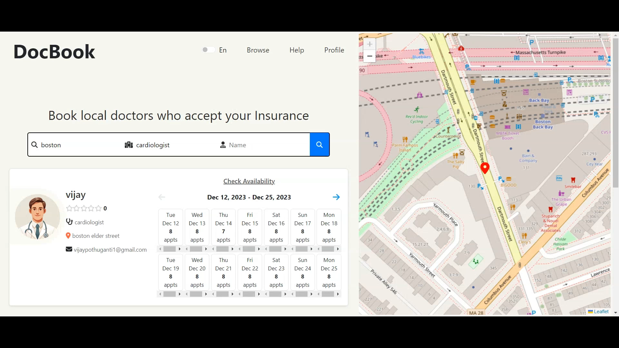
Appointment Booking Procedure

Slide 18
Thank You

